Slide 1
Introduction to Algorithms
Levon Prazyan

Slide 2
Course Overview
Introduction
1 lecture
Analyzing Algorithms
2 lectures
Recurrences
2 lectures
Probabilistic Analysis and Randomized Algorithms
2 lecture
Sorting and Searching
4 lectures
Heaps
1 lecture
Arrays, Lists
1 lectures
Stack, Queue, Double Ended Queue
2 lectures

Slide 3
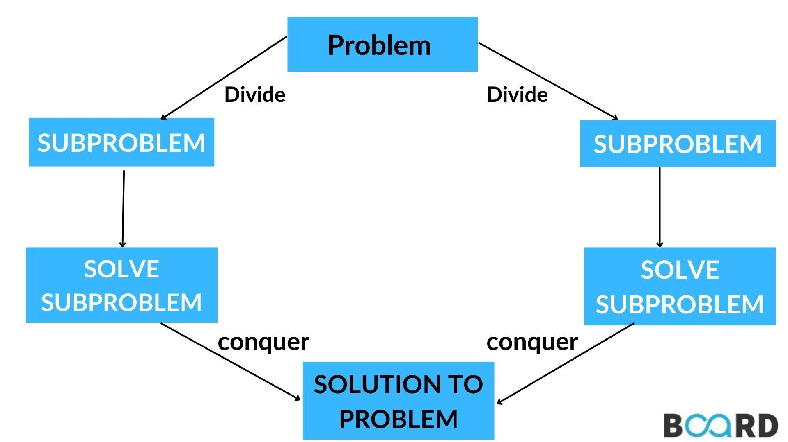
Devide and Counquer
Divide
Conquer
Combine

Slide 4
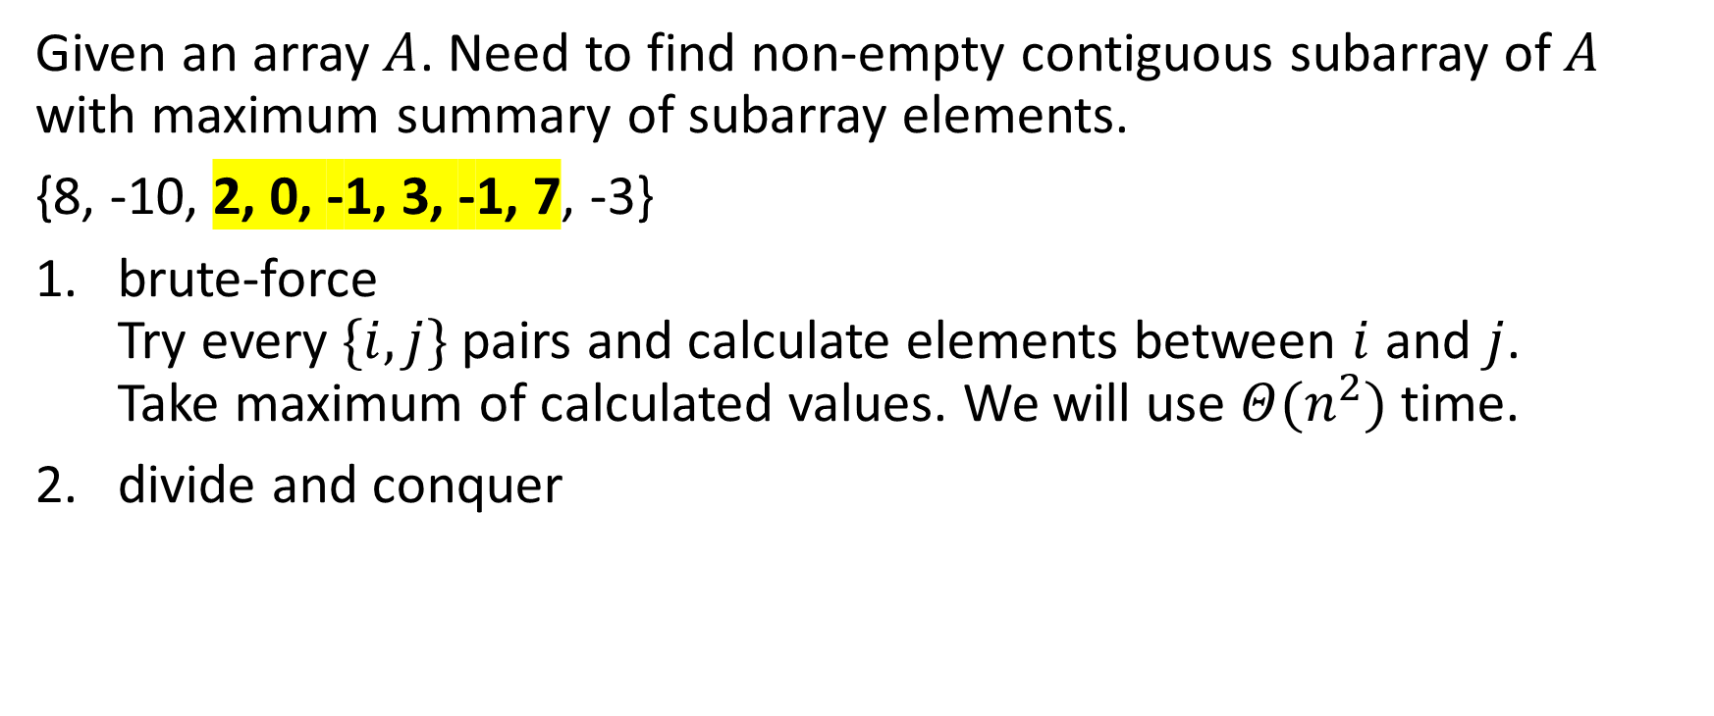
The maximum-subarray problem

Slide 5
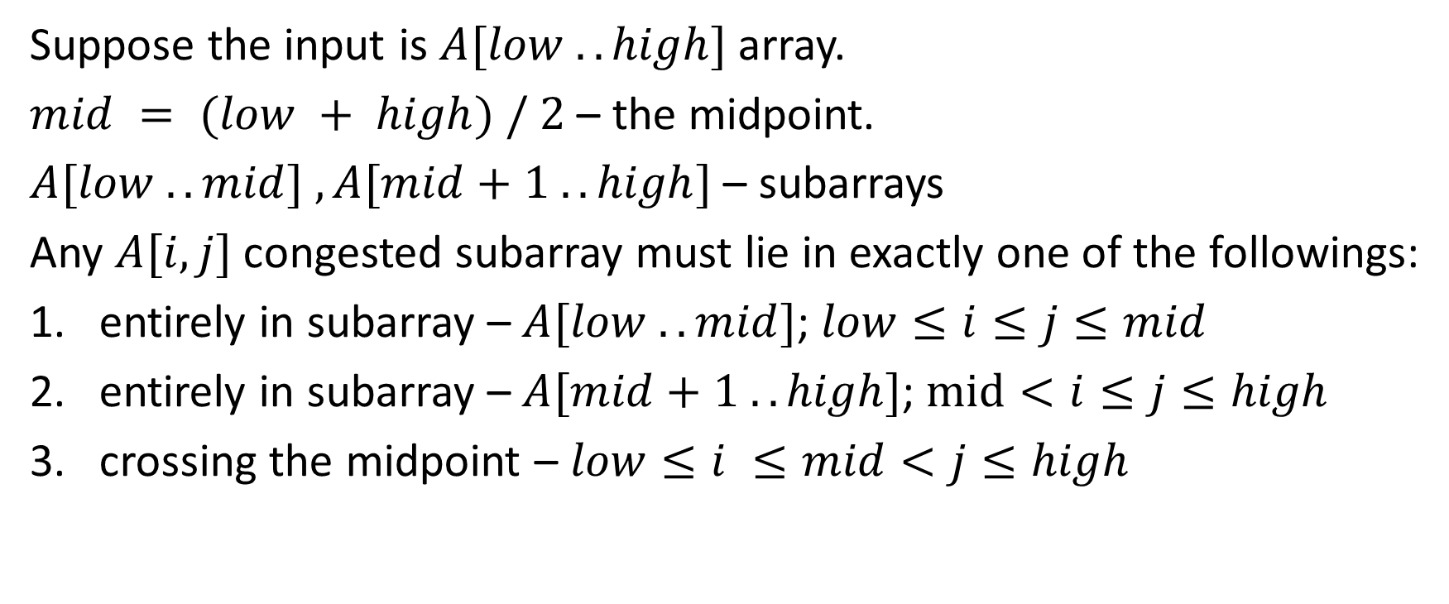
The maximum-subarray problem: Divide and conquer (1)

Slide 6
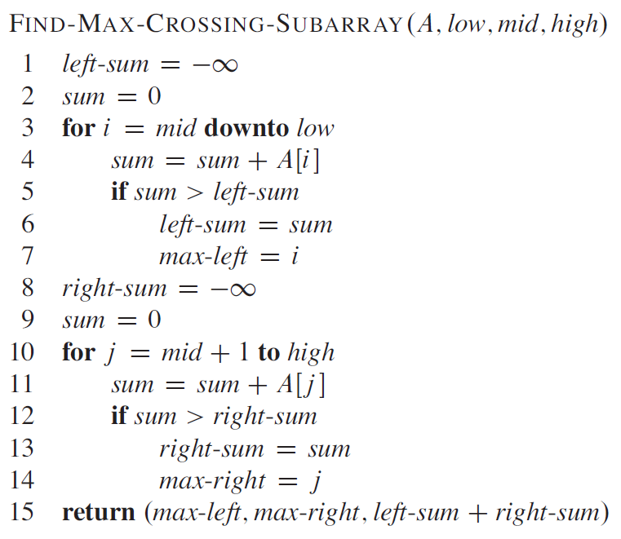
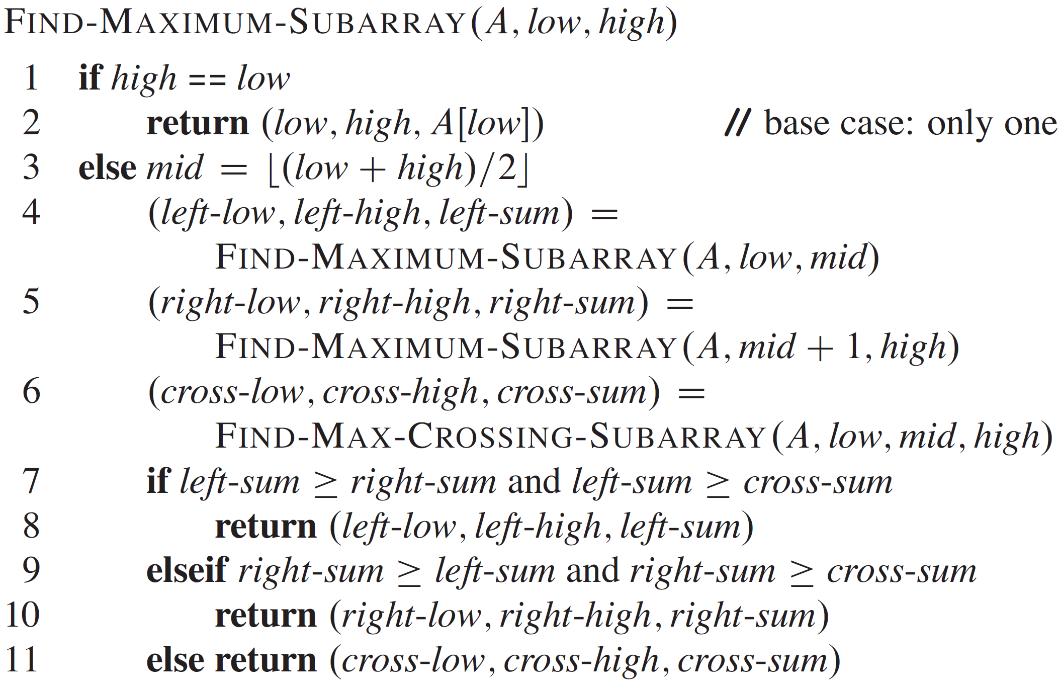
The maximum-subarray problem: Divide and conquer (2)

Slide 7
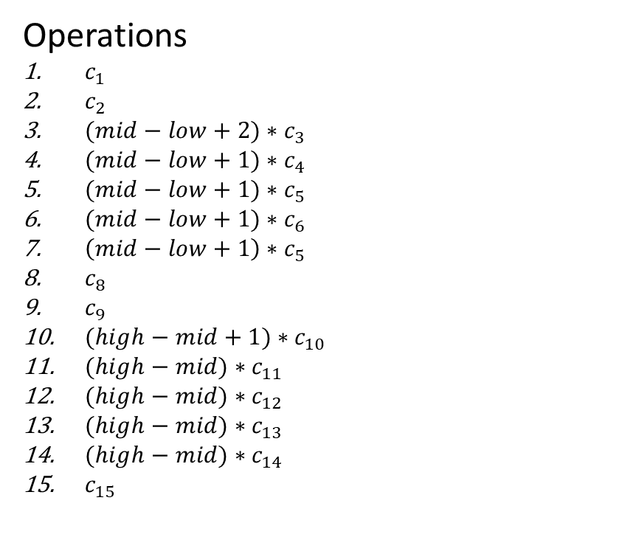
The maximum-subarray problem: Divide and conquer: Analysis (1)

Slide 8
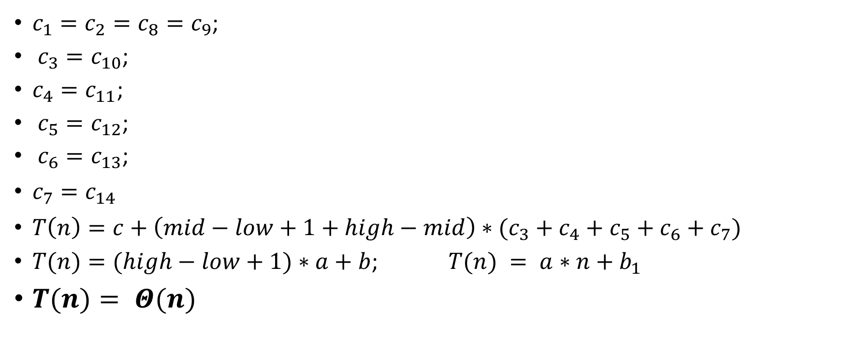
The maximum-subarray problem: Divide and conquer: Analysis (2)

Slide 9
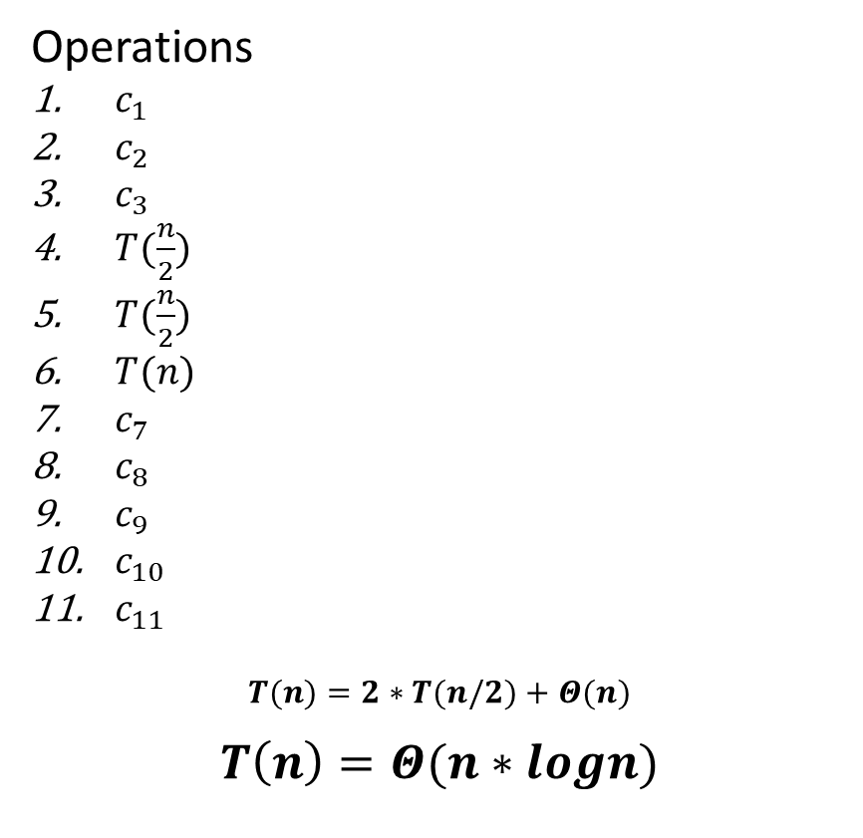
The maximum-subarray problem: Divide and conquer: Analysis (1)

Slide 10
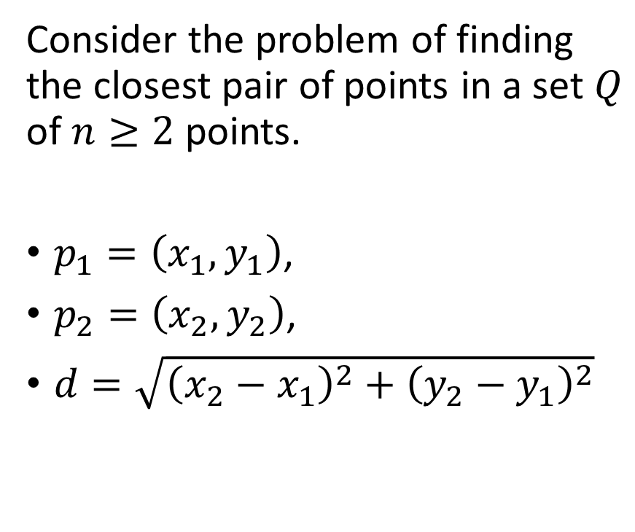
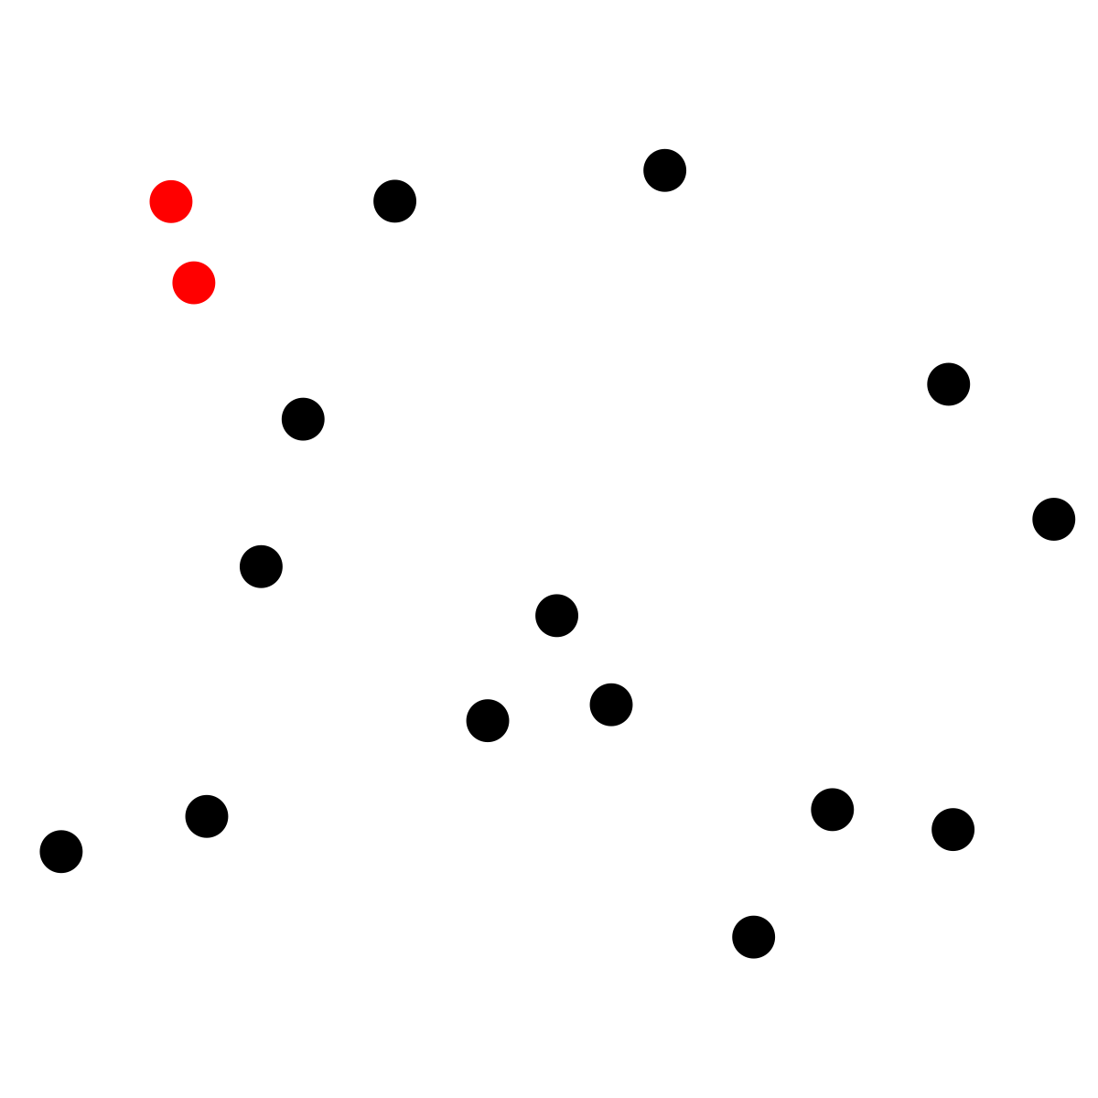
Closest Pair of Points (1)
Notes:
“Closest” refers to the usual Euclidean distance
A brute-force closest-pair algorithm simply looks all pairs and takes 𝑶(𝒏^𝟐) time.

Slide 11
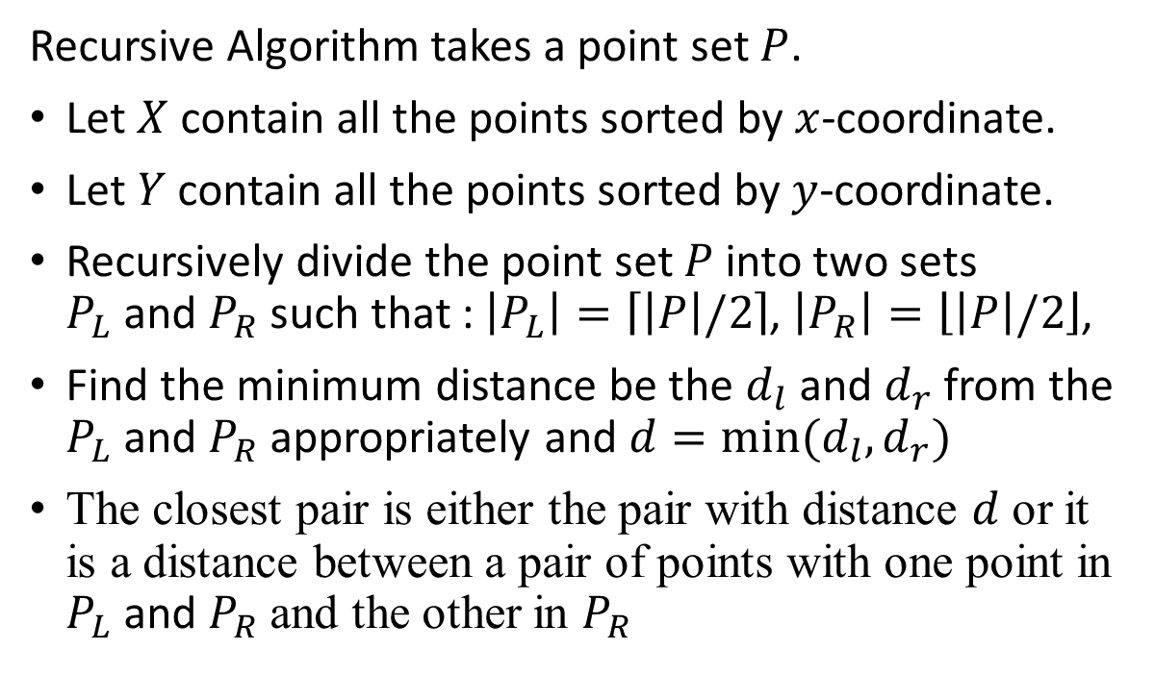
Closest Pair of Points: Divide-and-Conquer. (2)
Notes:
Sort the points by x-coordinate.

Slide 12
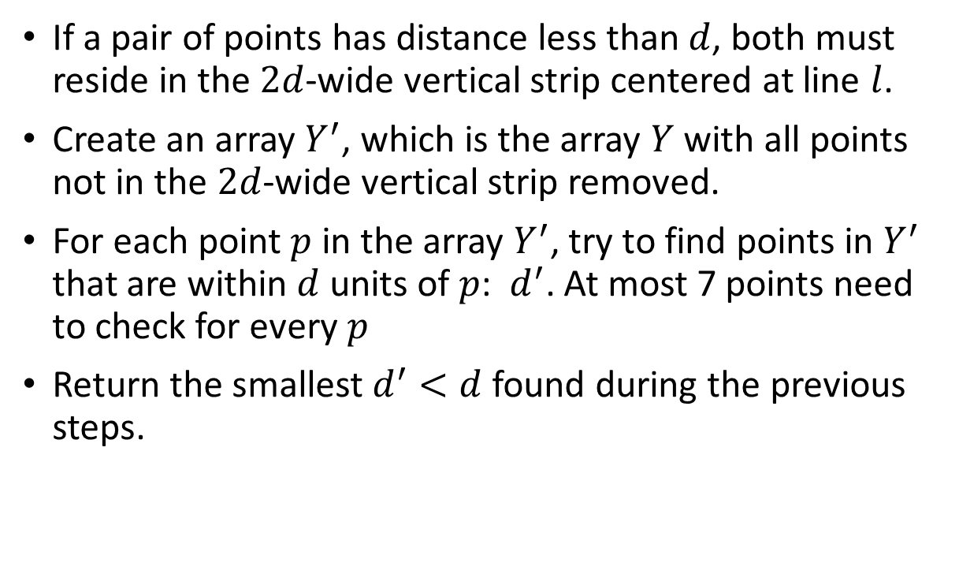
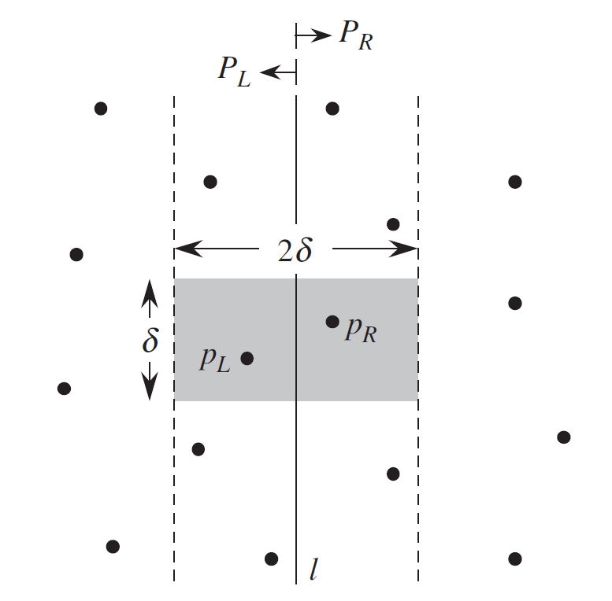
Closest Pair of Points: Divide-and-Conquer. (3)
Notes:
𝑌^′ is sorted by y-coordinate, just as Y is

Slide 13
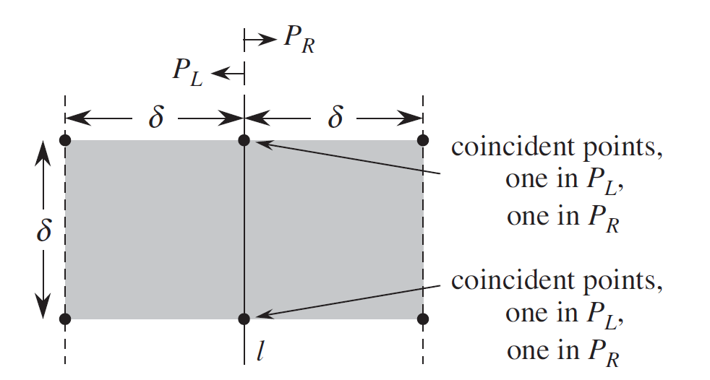
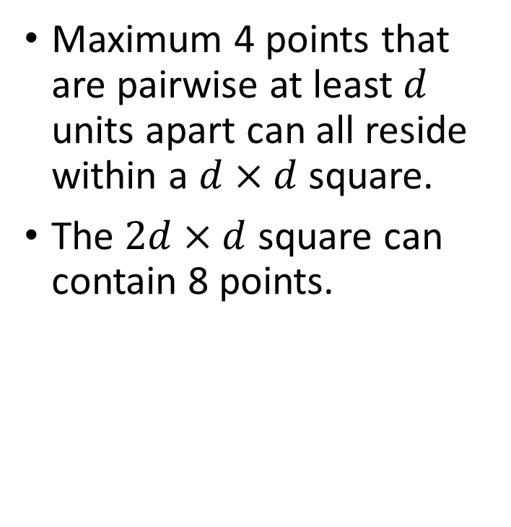
Closest Pair of Points: Divide-and-Conquer. (4)
Notes:
𝑌^′ is sorted by y-coordinate, just as Y is

Slide 14
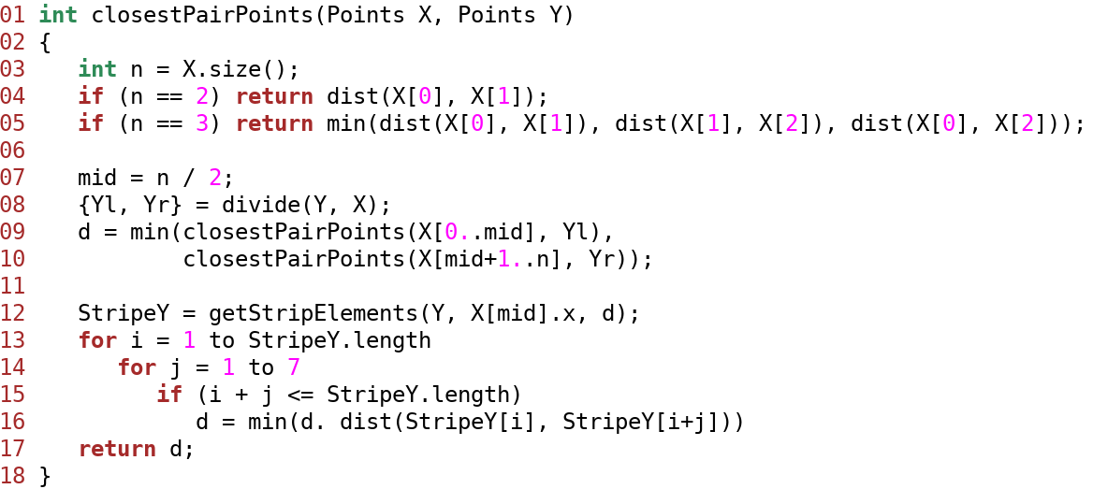
Closest Pair of Points: Divide-and-Conquer. (5)
Notes:
int closestPairPoints(Points X, Points Y)
{
int n = X.size();
if (n == 2) return dist(X[0], X[1]);
if (n == 3) return min(dist(X[0], X[1]), dist(X[1], X[2]), dist(X[0], X[2]));
mid = n / 2;
{Yl, Yr} = divide(Y, X);
d = min(closestPairPoints(X[0..mid], Yl),
closestPairPoints(X[mid+1..n], Yr));
StripeY = getStripElements(Y, X[mid].x, d);
for i = 1 to StripeY.length
for j = 1 to 7
if (i + j <= StripeY.length)
d = min(d. dist(StripeY[i], StripeY[i+j]))
return d;
}

Slide 15
Recursion
Recursion is a concept where a procedure calls itself in order to solve a problem. A recursive algorithm typically follows these steps:
Base Case
Recursive Case
Notes:
Base Case: : A simple condition or set of conditions where the recursion stops. This prevents the function from calling itself indefinitely.
Recursive Case: The function calls itself with a modified version of the original problem, moving toward the base case.

Slide 16
Solving Recurrences
Solving recurrences
Substitution method
Recursion-tree method
Master method
Notes:
Methods for solving recurrences – obtaining “𝛩” or “𝑂” bounds on the solution.

Slide 17


The Substitution Method
Guess the solution
Proof by induction

Slide 18
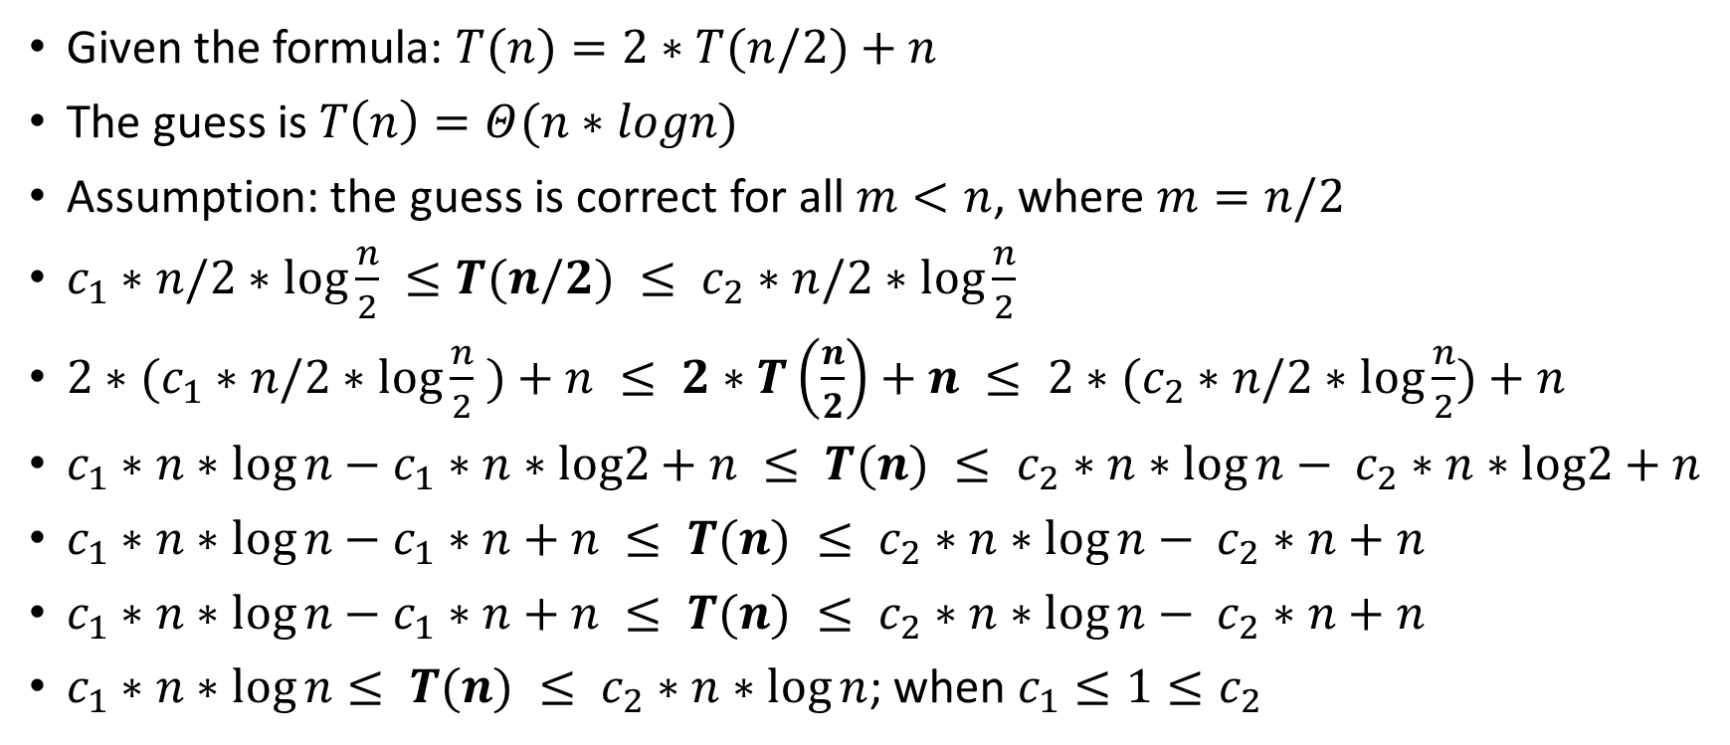
The Substitution Method: Example

Slide 19

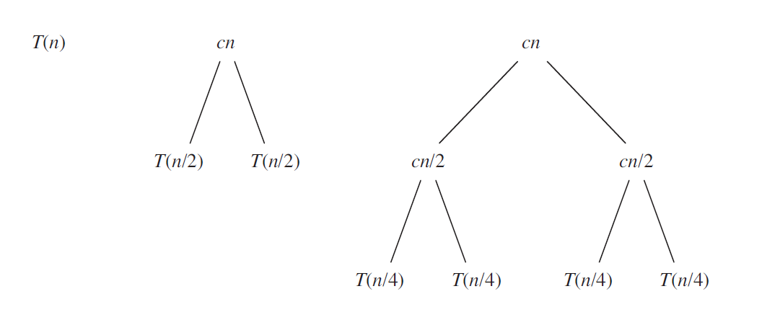
The Recursive-tree Method: Example 1 (1)

Slide 20
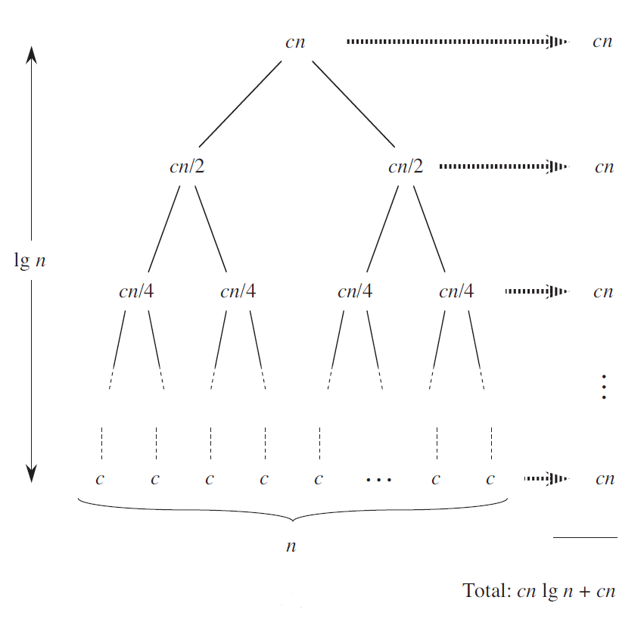
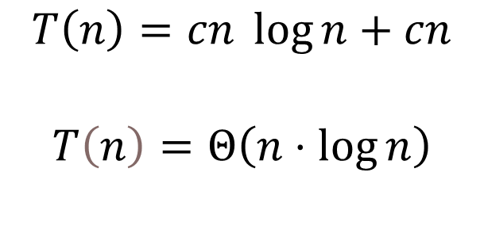
The Recursive-tree Method: Example 1 (2)

Slide 21

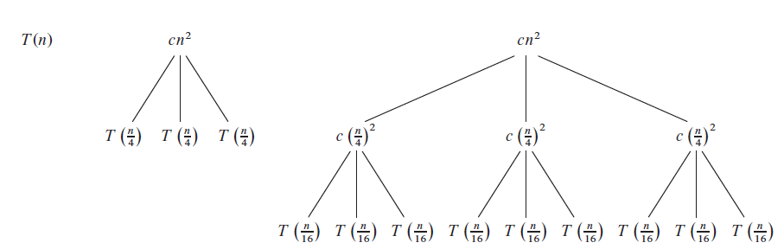
The Recursive-tree Method: Example 2 (1)

Slide 22
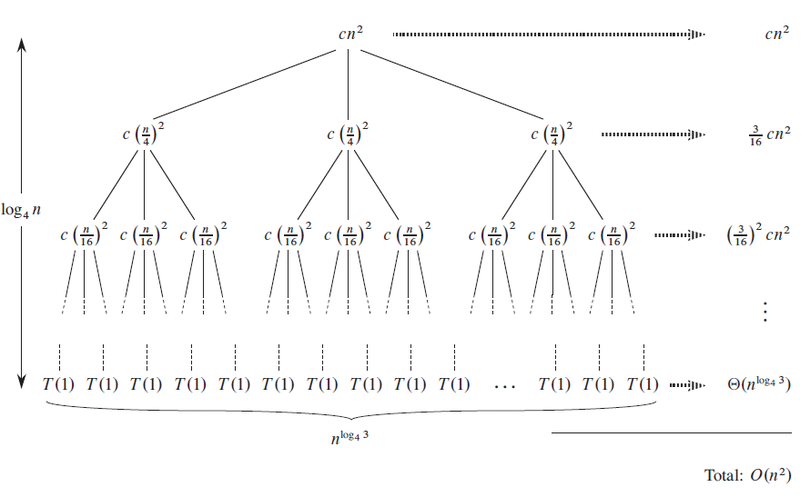
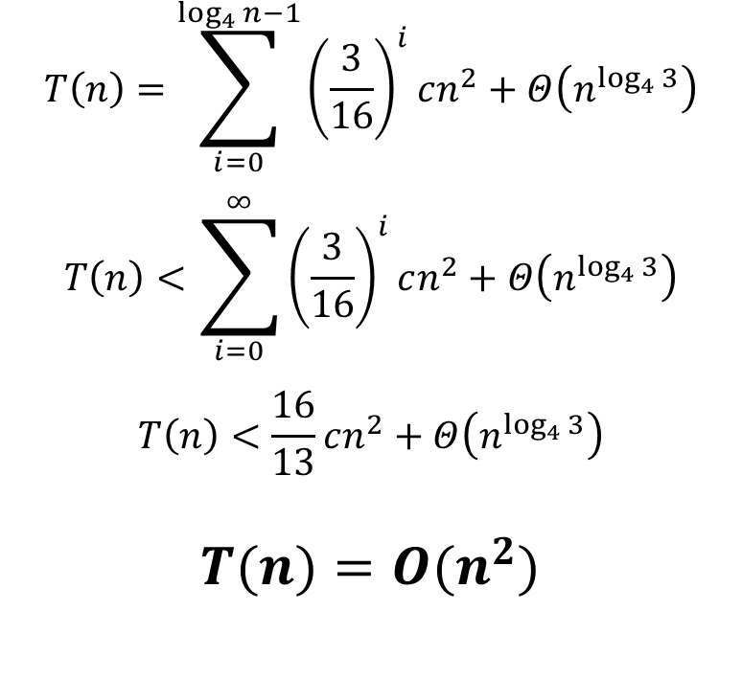
The Recursive-tree Method: Example 2 (2)

Slide 23
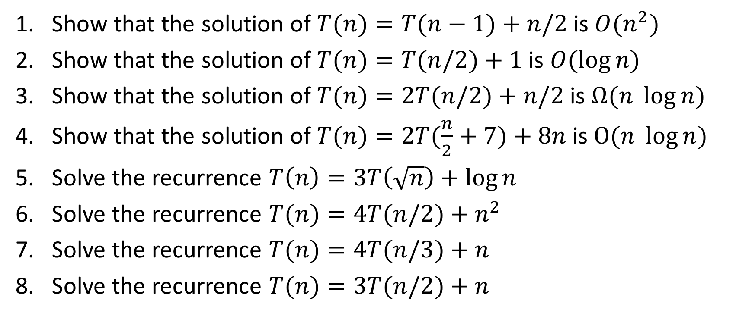
Exercises (1)

Slide 24
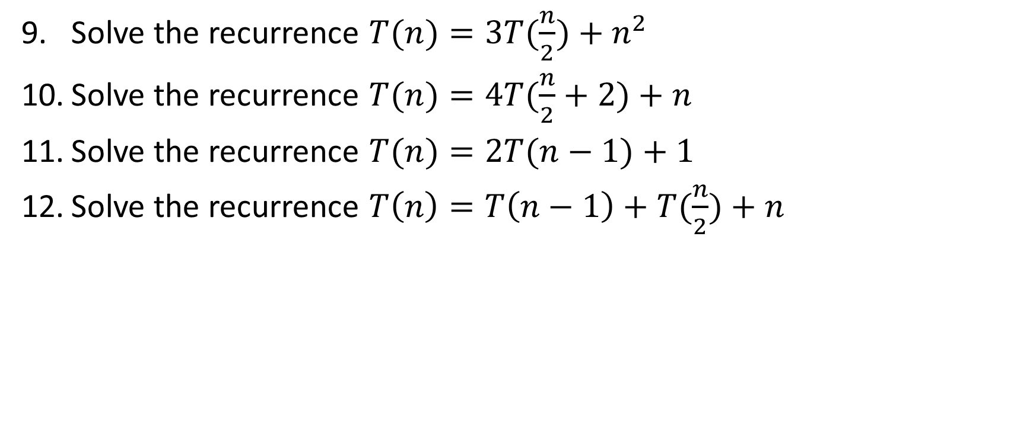
Exercises (2)

Slide 25
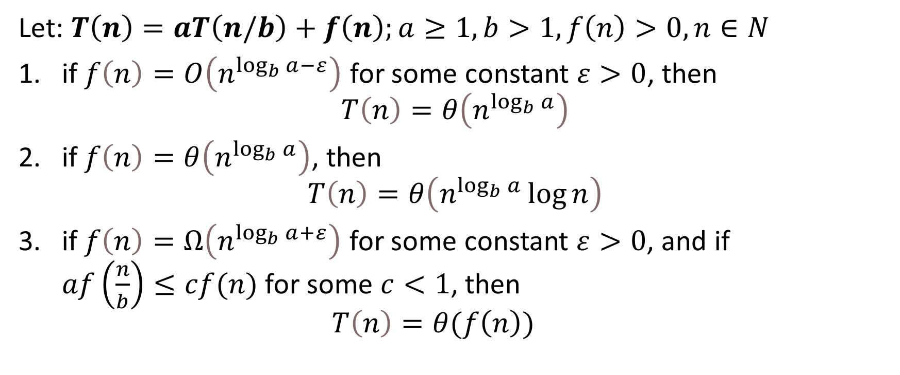
Master Method
Notes:
In each of the three cases, we compare the function f(n) with the function 𝑛^(log_𝑏 𝑎)
the larger of the two functions determines the solution to the recurrence

Slide 26
Master Method: Proof (1)
Analyze the for
Extend the analysis to all positive integers.

Slide 27
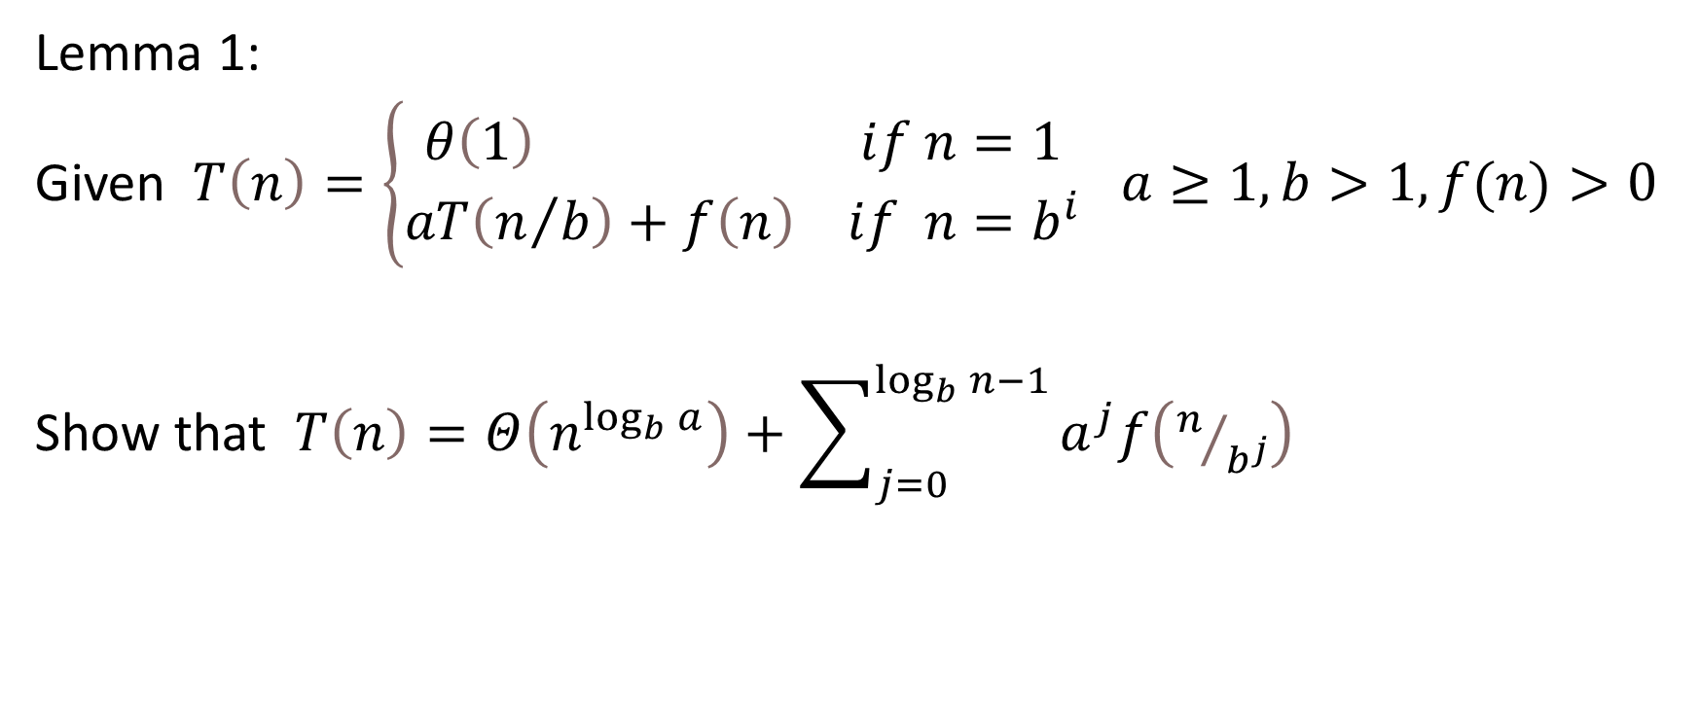
Master Method: Proof (2)

Slide 28
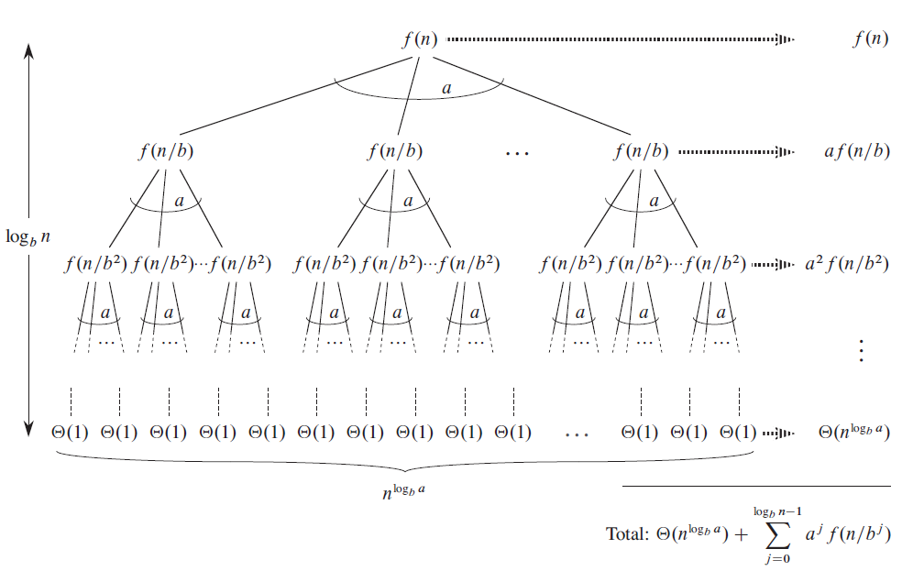
Master Method: Proof (3)

Slide 29
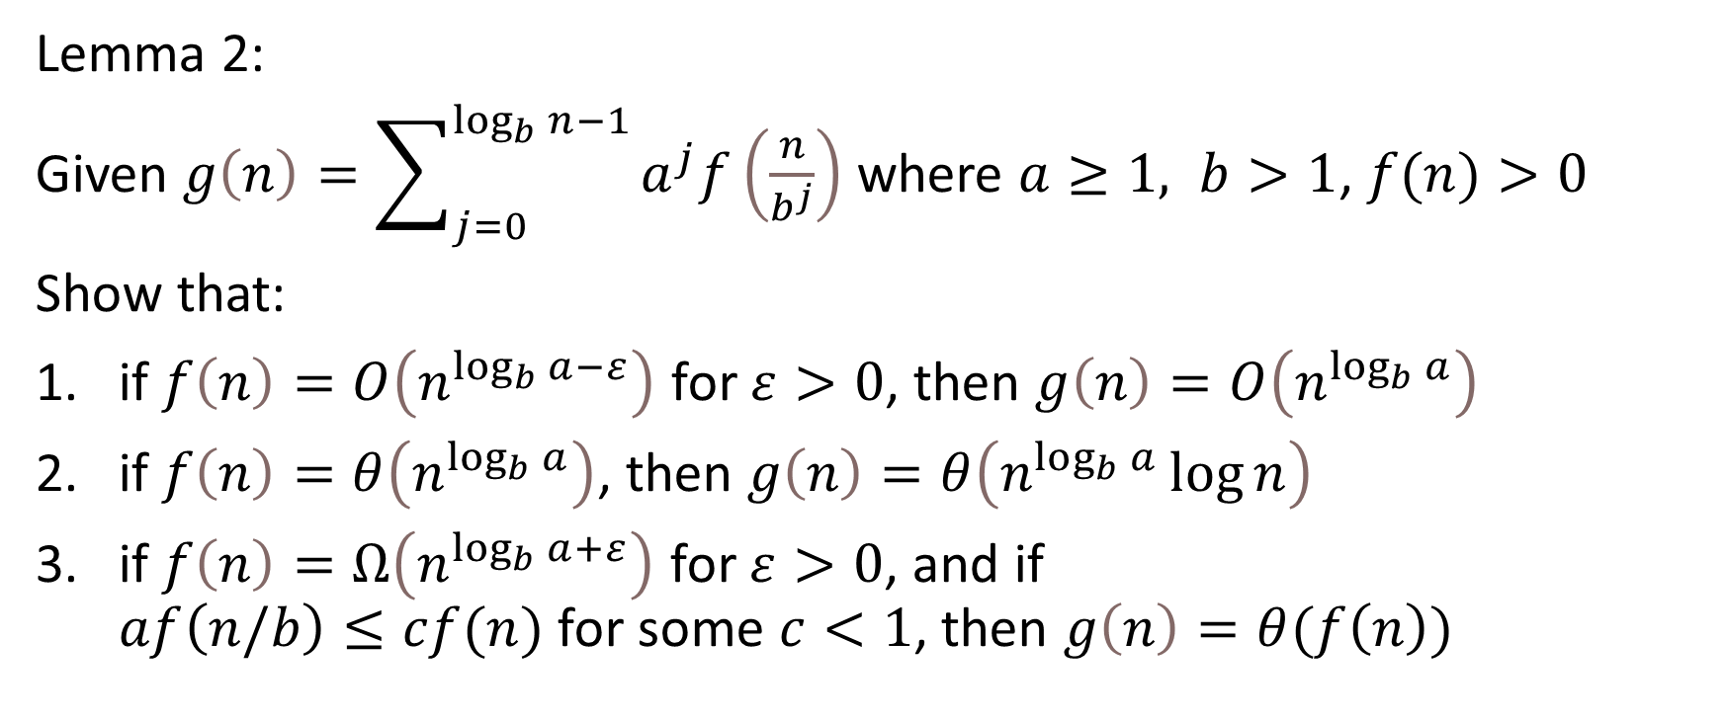
Master Method: Proof (4)

Slide 30
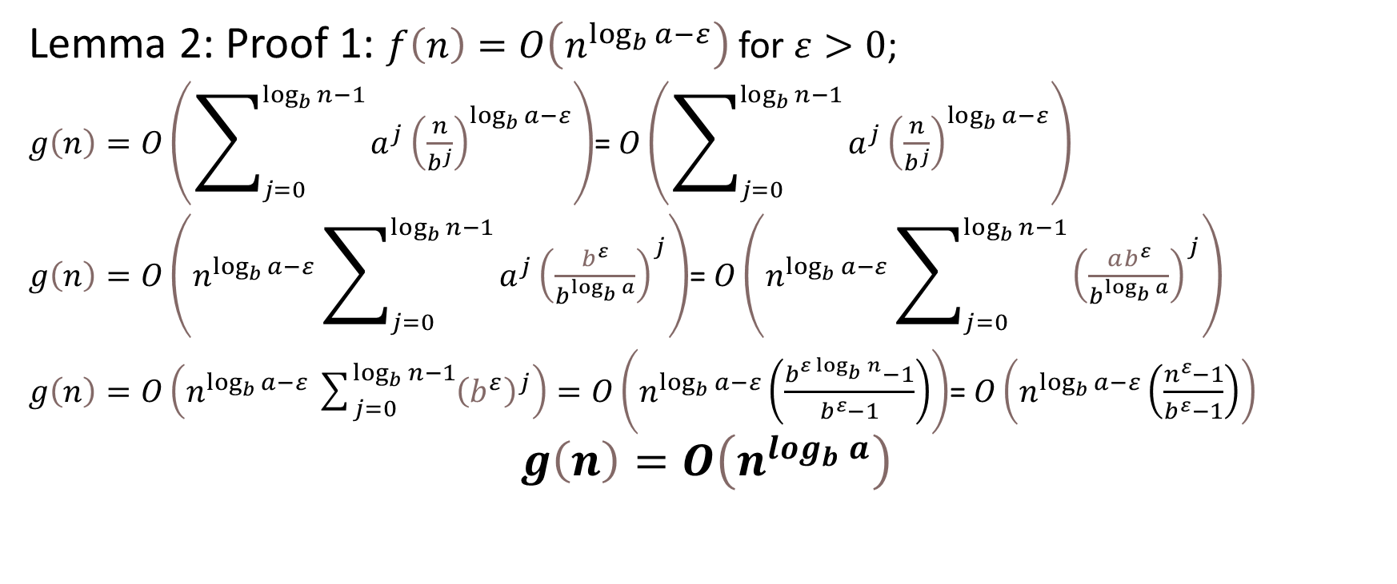
Master Method: Proof (5)

Slide 31
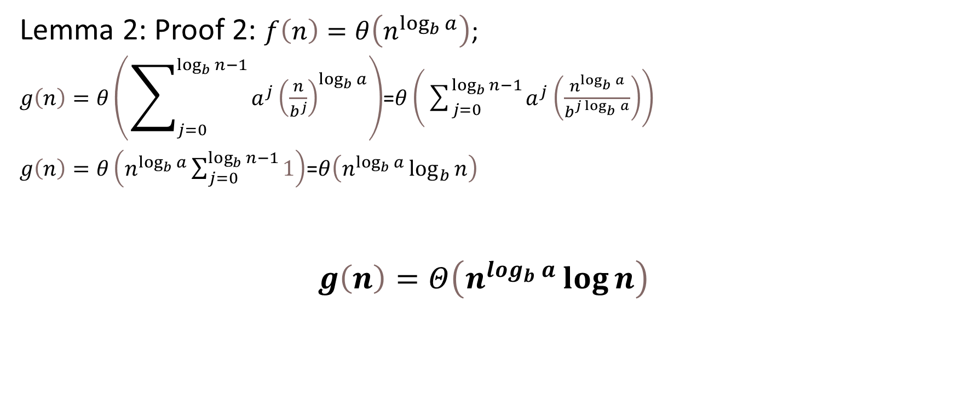
Master Method: Proof (6)

Slide 32
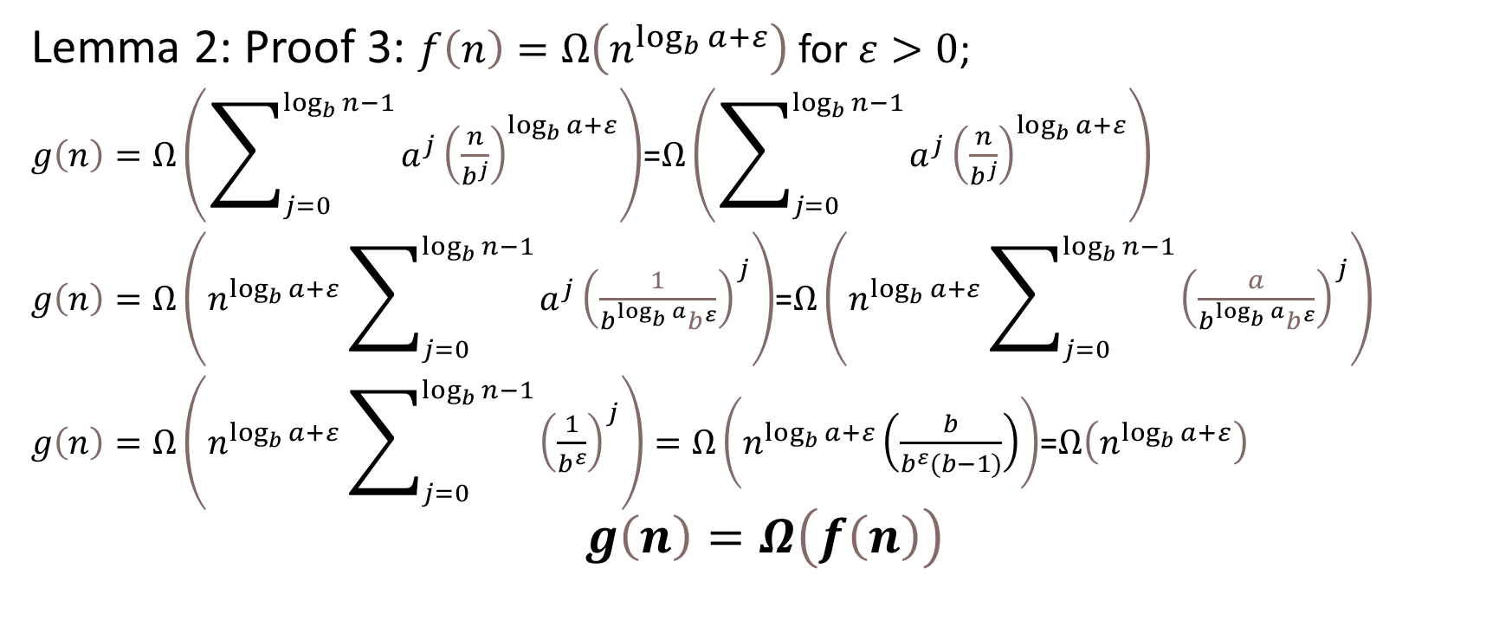
Master Method: Proof (7)

Slide 33
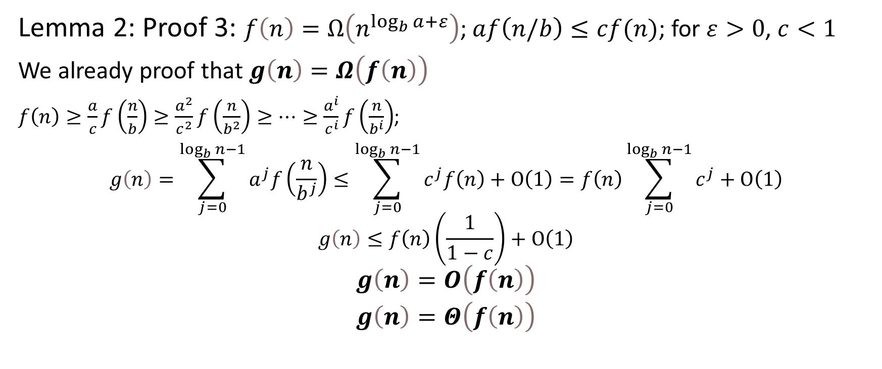
Master Method: Proof (8)

Slide 34
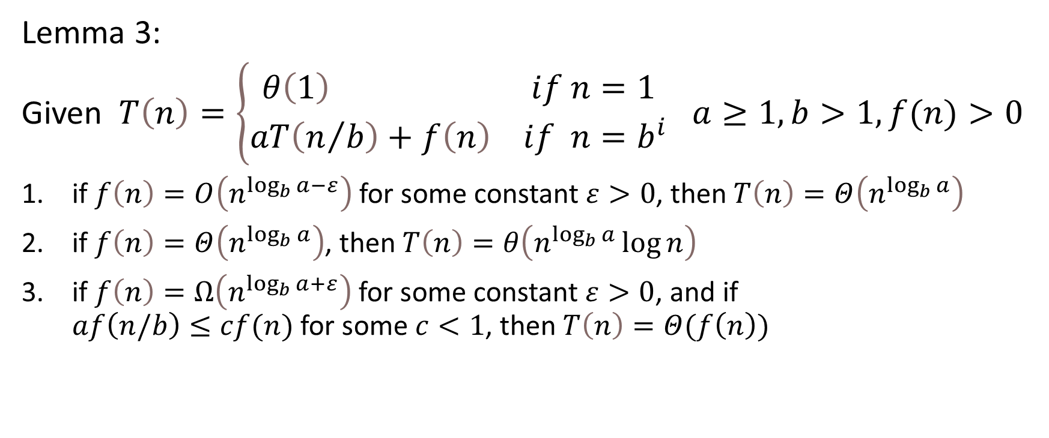
Master Method: Proof (9)
Notes:
In each of the three cases, we compare the function f(n) with the function 𝑛^(log_𝑏 𝑎)
the larger of the two functions determines the solution to the recurrence

Slide 35
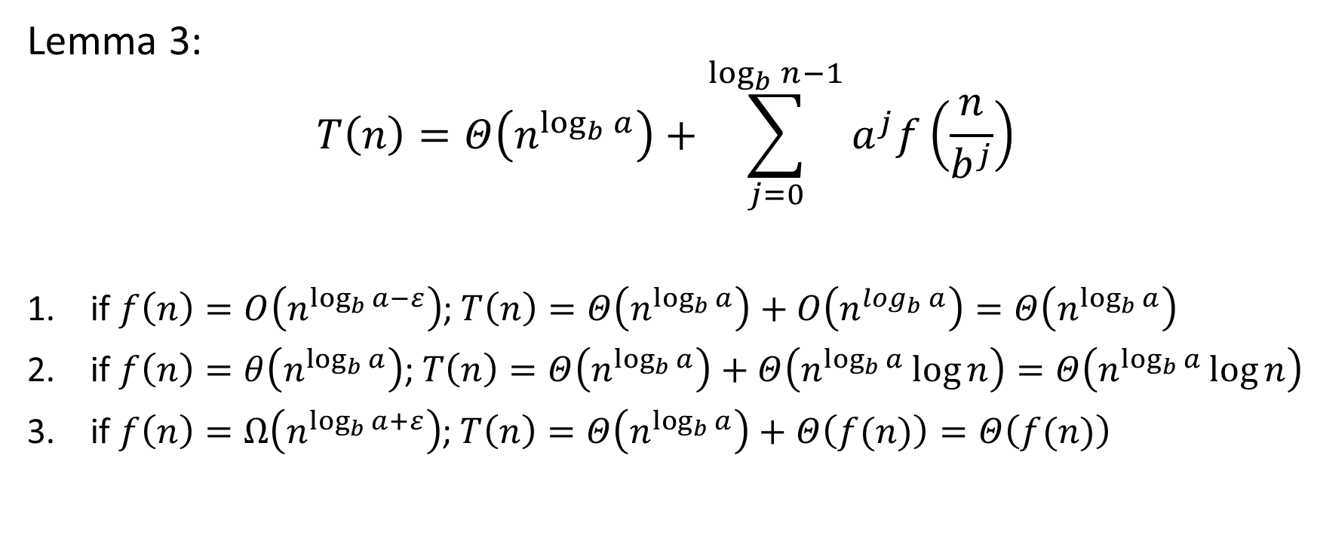
Master Method: Proof (10)

Slide 36
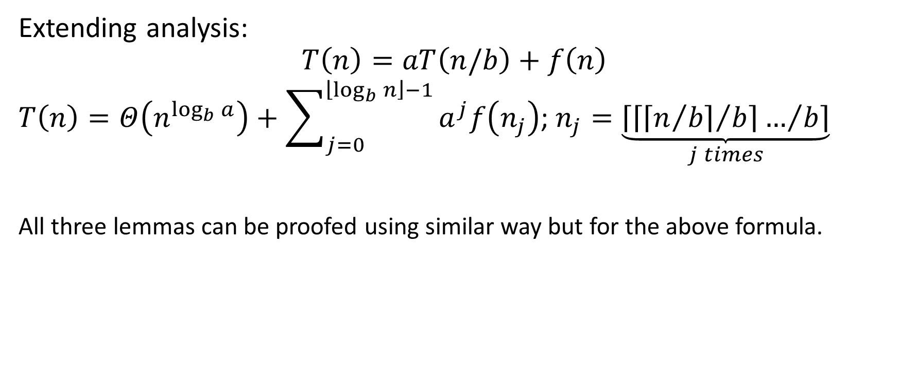
Master Method: Proof (11)

Slide 37
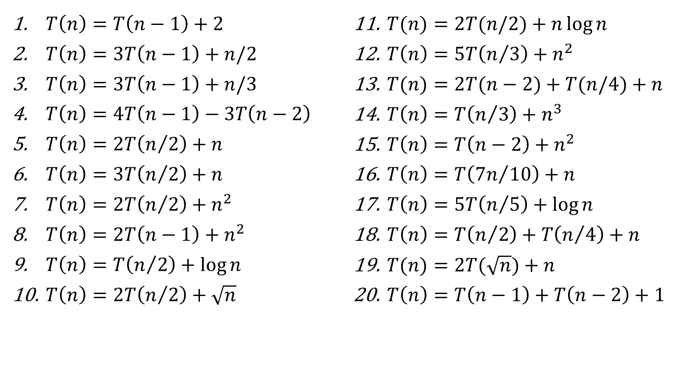
Exersises: Solve Recurrences

Slide 38
Thank You

